Slide 1
Order of convergence - Applications

Slide 2
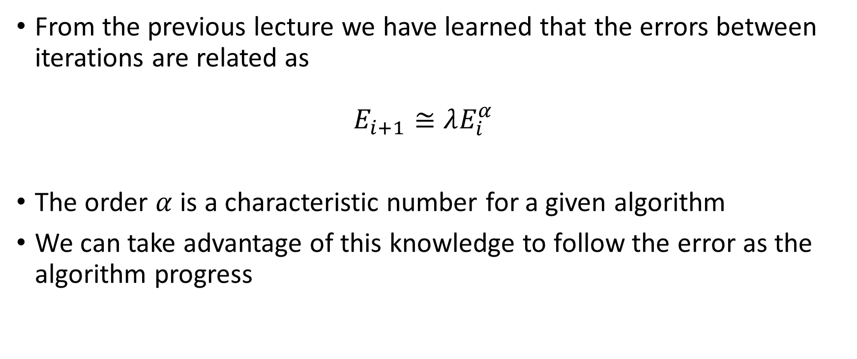
From the previous lecture we have learned that the errors between iterations are related as $E_{i+1}≅λE_{i}^{α}$
The order $α$ is a characteristic number for a given algorithm
We can take advantage of this knowledge to follow the error as the algorithm progress
Notes:
In this lecture we are going to see on a practical example how the concept of order of convergence can be used.
Recall that we learned that errors between two iterations are related as ei+1 is about lambda time ei to the power alpha
The number alpha is a characteristic number of a given algorithm
Let us now see how we can take advantage of this knowledge.

Slide 3
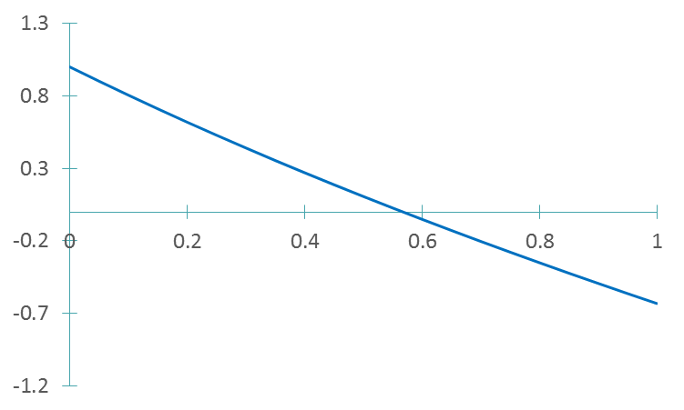



An example
Consider the equation
$$e^{−x}−x=0$$
$${y=e}^{−x}−x$$
$$r≈0.6$$
Notes:
Let us consider the equation $e^{−x}−x=0$
If we plot the function ${y=e}^{−x}−x$ we can observe that there is a root near the value of 0.6

Slide 4
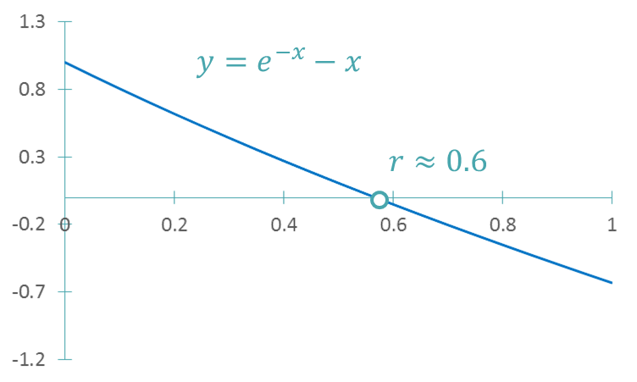
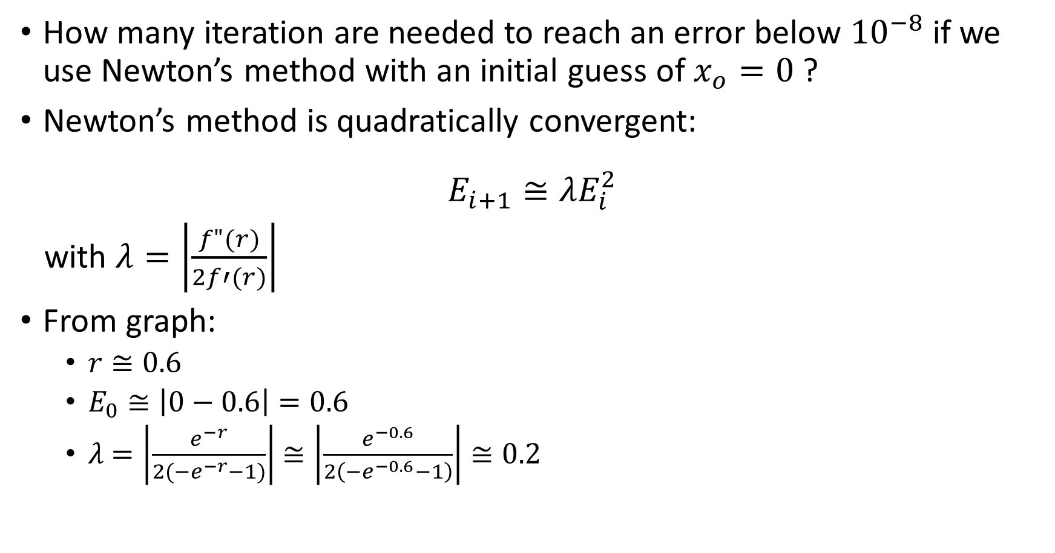
How many iteration are needed to reach an error below ${10}^{−8}$ if we use Newton’s method with an initial guess of $x_{o}=0$ ?
Newton’s method is quadratically convergent:
$$E_{i+1}≅λE_{i}^{2}$$
with $λ=\left|\frac{f"(r)}{2f′(r)}\right|$
From graph:
$r≅0.6$
$E_{0}≅\left|0−0.6\right|=0.6$
$λ$ $=\left|\frac{e^{−r}}{2(−e^{−r}−1)}\right|$ $≅\left|\frac{e^{−0.6}}{2\left(−e^{−0.6}−1\right)}\right|≅0.2$
Notes:
Let us now try to estimate how many iterations are needed to reach an error below 10^-8 if we use Newton’s algorithm and an initial guess xo=0.
Recall that Newton’s method is quadratically convergent with the error constant $λ=\left|\frac{f"(r)}{2f′(r)}\right|$.
From the graph we can estimate that
The root r is about 0.6
The initial error eo will be about $\left|0−0.6\right|=0.6$
And for the error constant lambda we can estimate it to about 0.2 by using the approximation 0.6 for the root r.

Slide 5
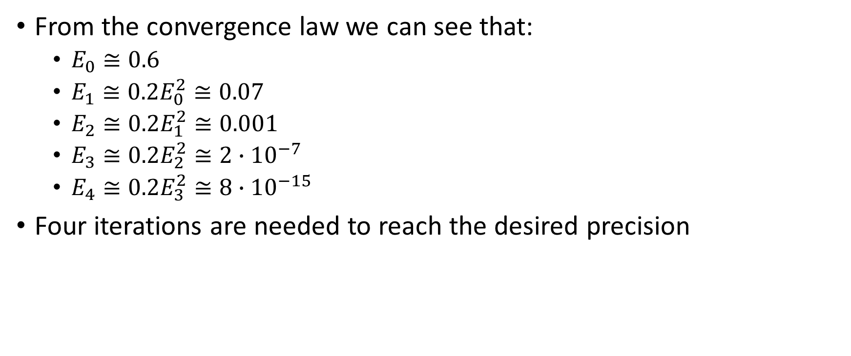
From the convergence law we can see that:
$E_{0}≅0.6$
$E_{1}≅0.2E_{0}^{2}≅0.07$
$E_{2}≅0.2E_{1}^{2}≅0.001$
$E_{3}≅0.2E_{2}^{2}≅2∙{10}^{−7}$
$E_{4}≅0.2E_{3}^{2}≅8∙{10}^{−15}$
Four iterations are needed to reach the desired precision
Notes:
We have now all the ingredients needed to estimate the number of iterations that will be needed to reach an error below 10^-8.
The initial error eo is about 0.6
Consequently the error e1 in the first iteration will be about $0.2e_{0}^{2}≅0.07$
The same way we can estimate the error in the second iteration
And in the third
And in the fourth.
In the fourth iteration we expect to reach an error of around $8∙{10}^{−15}$ which is below the set tolerance of 10^-8. In the third one we didn’t yet reach it.
In summary we expect that about four iterations will be required

Slide 6
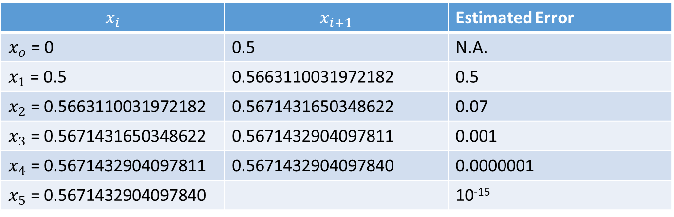
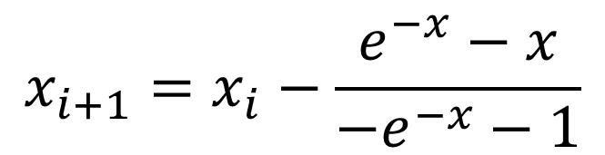

Verification
$$x_{i+1}=x_{i}−\frac{e^{−x}−x}{{−e}^{−x}−1}$$
$$e^{−x}−x=0$$
$$x_{i}$$ | $$x_{i+1}$$ | Estimated Error
$x_{o}$ = 0 | 0.5 | N.A.
$x_{1}$ = 0.5 | 0.5663110031972182 | 0.5
$x_{2}$ = 0.5663110031972182 | 0.5671431650348622 | 0.07
$x_{3}$ = 0.5671431650348622 | 0.5671432904097811 | 0.001
$x_{4}$ = 0.5671432904097811 | 0.5671432904097840 | 0.0000001
$x_{5}$ = 0.5671432904097840 |  | 10⁻¹⁵
Notes:
Let us verify this finding
For this let us write down Newton’s algorithm for the particular case of our equation.
Filling the table in the way we have learned and estimating the error with the technique we learned so far we see that indeed after about 4-5 iterations we reach the desired precision.

Slide 7
Second application
There is a second way to use the concept of order of convergence
It allows us to check if our calculations are sound as the estimated errors must decrease according the known convergence rate
If the estimated errors do not decrease according the expected convergence order, it shows that something is wrong
Notes:
There is a second way to use the concept of order of convergence
It allows us to check if our calculations are sound as the estimated errors must decrease according the known convergence rate
If the estimated errors do not decrease according the expected convergence order, it shows that something is wrong

Slide 8

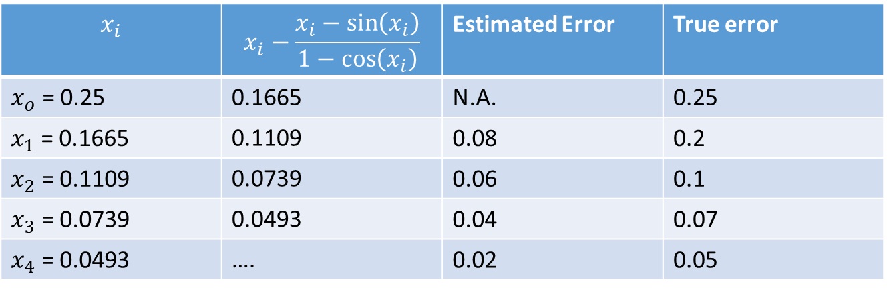
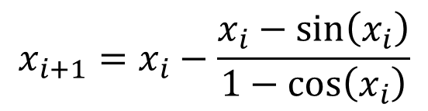
Example
Solve $x−\sin\left(x\right)=0$ with Newton’s algorithm
$$x_{i+1}=x_{i}−\frac{x_{i}−sin\left(x_{i}\right)}{1−cos\left(x_{i}\right)}$$
$$x_{i}$$ | $$x_{i}−\frac{x_{i}−sin\left(x_{i}\right)}{1−cos\left(x_{i}\right)}$$ | Estimated Error | True error
$x_{o}$ = 0.25 | 0.1665 | N.A. | 0.25
$x_{1}$ = 0.1665 | 0.1109 | 0.08 | 0.2
$x_{2}$ = 0.1109 | 0.0739 | 0.06 | 0.1
$x_{3}$ = 0.0739 | 0.0493 | 0.04 | 0.07
$x_{4}$ = 0.0493 | …. | 0.02 | 0.05
Notes:
To illustrate this idea let us have a look to the equation x-sin(x)=0
You may recall that we already tried to solve this equation numerically with the fixed point iteration and we got not good error estimations.
Let us try this time with Newton’s method.
First we write down Newton’s algorithm for this particular equation
Then we build a table as usually.
Note that again our way to estimates the error is by far not good.
Still we largely underestimates the errors.
For example in iteration number four we estimate the error to be 0.02, whereas the true error is 0.05, more than two times larger.
If we wouldn’t know the true answer, at this stage we wouldn’t know that there is a problem.
But by observing the estimated errors we can detect that there must be an issue.
Indeed, the estimated errors do not decrease according a quadradtic convergence.
For example, in iteration number three we have an estimated error of 0.04.
From this we would expect to get in iteration four an error of about 0.04 to the power 2, which would be 0.001.
This is not what we get.
In fact, observing the column of estimated errors, we conclude that the algorithm is converging linearly and not at all quadratically , as it should.

Slide 9
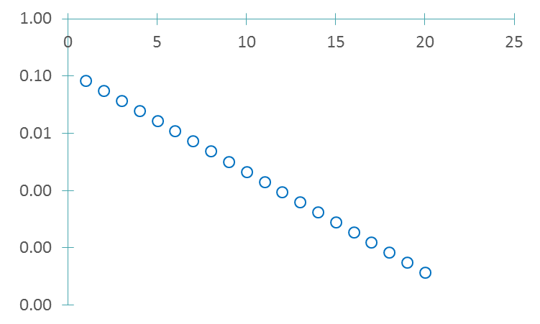


Example
Number of iterations $i$
Error $E_{i}$
Notes:
If we plot the estimated errors in function of the number of iterations this behavior is even more obvious.
The errors do decrease linearly and not at all quadratically
This allows us to conclude that indeed something is going wrong when we solve the equation x-sin(x)=0

Slide 10
Summary
Knowing the order of convergence of an algorithm allows us to estimate how many iterations are needed to reach a desired precision
It allows us as well to check if our calculations are sound as the estimated errors must decrease according the known convergence rate
Notes:
Let us summarize the key findings
Knowing the order of convergence of an algorithm allows us to estimate how many iterations are needed to reach a desired precision
It allows us as well to check if our calculations are sound as the estimated errors must decrease according the known convergence rate

